Slide 1

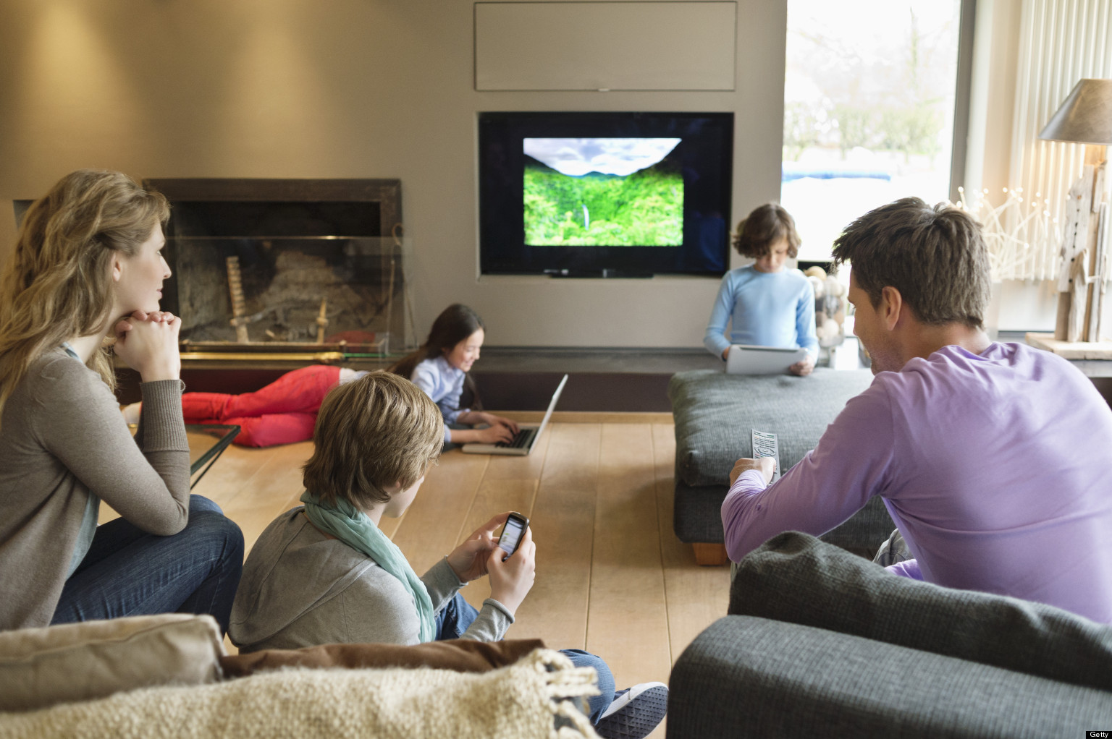
Enjoy using technology together
This Photo by Unknown Author is licensed under CC BY-SA

Slide 2
Building blocks to enjoy technology
Sharing technology together
Talking about use of technology
Showing good use of technology
Agreeing family rules for use of technology
Setting appropriate controls
Check your knowledge of new technology
Notes:
Sharing technology together is key to building positive family use. Sets expectation as children get older.
Important to talk about the precautions to talk but also for children to see the positive and appropriate ways adults use technology
It may seem young to agree rules – again this sets an expectation. The rules will be re-negotiated as they get older but it’s much easier to start at 4 and 5 years olds rather than to do it for the first time when your children are 10 or 11.
Whenever you have new technology in the house or use new apps, it is always important to check out what is possible and what precautions you will need to take.

Slide 3

Please let me …
I want to ...
Notes:
Set an expectation of children asking before they use technology – same as asking before they go outside to play

Slide 4

I can see you.
Can you see me?
Notes:
Set expectation that an adult will always be near to them when they use technology. Get them used to you being near by even when they are sharing it with friends or older syblings.

Slide 5

Play with me.
Look what I can do.
Notes:
Set the expectation that technology is something we share. It’s not something they will sit in a corner or in their bedroom to use by themselves. This will change when they get older but it sets a principal that protect them now. When they begin to use technology independently it is important that initially they know this isn’t something that is private but something you will be part of to start with. You may need to explain the difference in terms of you using technology privately!

Slide 6

I like that.
Please can I take your picture.
Would you like to have a go?
Notes:
It’s never too early to emphasise the need to always be kind when you use technology. When they are young this is about taking turns or asking before taking a photo.

Slide 7

I don’t like this.
Help me.

Slide 8

I need to stretch and move around every 30 minutes

Slide 9

What other things do I do?
What else shall we do together?

Slide 10

Is this the right time?
Time to stop now.
Time to do something else.
Notes:
Short bursts of time are better than prolonged use.
What they are doing and how they are doing it are more important. If your child is sat by themselves playing a repetitive game that is such a different experience than you playing the game with them or sat beside them talking about what they are doing. You may be facetiming or skyping a relative together. You may be reading an e-book together.
Important that children know that when you say time is up they stop and do something else.

Slide 11

What would you say to Gran?
Notes:
Use for discussion of what children see as appropriate use as well as our expectations of our children’s use.

Slide 12
Managing screen time
Is your family's screen time under control?
Does screen use interfere with what your family want to do?
Does screen use interfere with sleep?
Are you able to control snacking during screen time?
Stop use an hour before bed-time
Establish age-appropriate boundaries, negotiated by parent and child, that everyone in the family understands
Royal College of Paediatrics and Child Health (RCPCH) January 2019
Notes:
Manage risks and benefits
Overall, it found the effect of screen time on children's health was small when considered next to other factors like sleep, physical activity, eating, bullying and poverty.
It said there was a lack of evidence that screen time is beneficial for health or wellbeing.

Slide 13
Managing screen time
Mealtimes can be good opportunities for screen-free zones
If children's screen time use seems out of control, parents should consider intervening
Parents should think about their own screen use, including whether they use devices unconsciously too often
Younger children need face to face social interaction and screens are no substitute for this
Establish age-appropriate boundaries, negotiated by parent and child, that everyone in the family understands
Royal College of Paediatrics and Child Health (RCPCH) January 2019
Notes:
Manage risks and benefits
Overall, it found the effect of screen time on children's health was small when considered next to other factors like sleep, physical activity, eating, bullying and poverty.
It said there was a lack of evidence that screen time is beneficial for health or wellbeing.

Slide 14
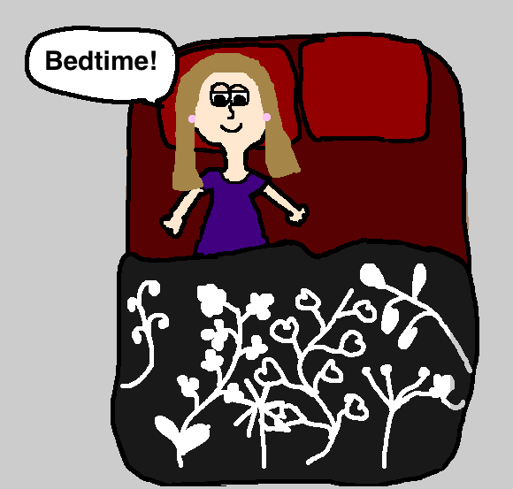
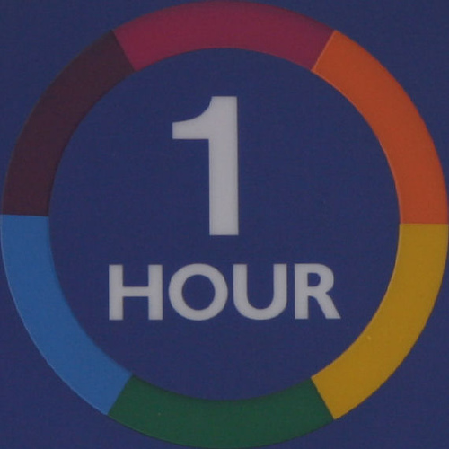
This Photo by Unknown Author is licensed under CC BY
This Photo by Unknown Author is licensed under CC BY-NC-ND

Slide 15
Advice
Short bursts of screen time.
Think about what children see you doing.
Avoid devices in a child’s bedroom.
Check PEGI rating for games and apps.
Consider parental controls on your broadband, streaming services and devices.
Notes:
We are advised to record children playing age inappropriate games as a safeguarding concern – emotional abuse.
What parent controls are sensible / practicable? The NSPCC/02 helpline is always there to help you. 0808 8005002

Slide 16
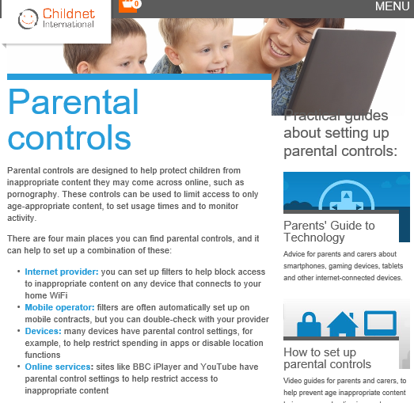
Tools to help you
Phone 02 and NSPCC online safety helpline
0808 800 5002
Notes:
Use tools where you need to, but don’t rely on them. Build resilience as well as protection.

